Slide 1
Remote Desktop
Application
Computer Networks

Slide 2
Muhammad Balach
Asfand Yar
Team Contribution
Code Developer
Project Report
User Manual
Code Functions, jar and exe file
GUI Designer
Create Presentation

Slide 3
Project Objective
The objective of our project is to develop a robust and user-friendly Remote Desktop Application that allows users to efficiently and securely control and monitor remote systems from anywhere. This application aims to provide seamless integration of remote desktop control, file transfer, screen sharing.

Slide 4
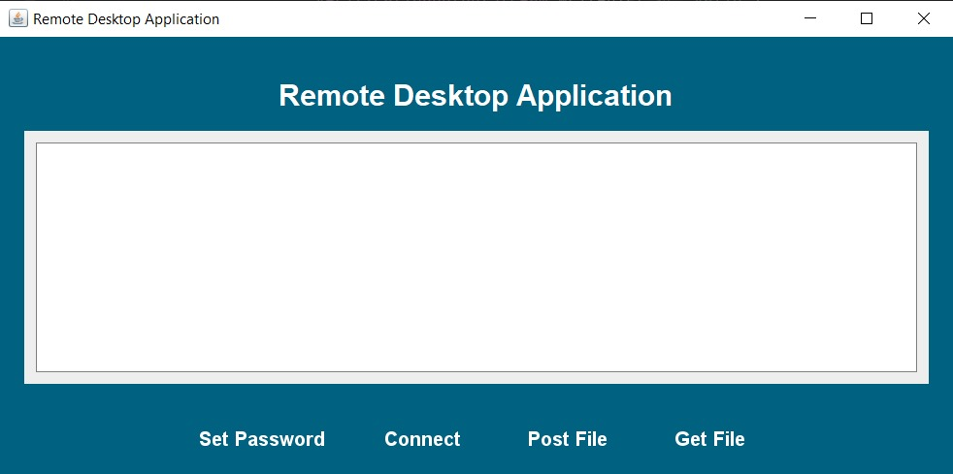
Project GUI

Slide 5
Libraries Definition
Client.Start:
Part of the custom client package for initiating the remote desktop application.
Server.SetPassword:
Part of the custom server package for handling password settings in the remote desktop application.
javax.swing:
A Java library for building graphical user interfaces (GUIs). It provides components such as buttons, text fields, and panels.
java.awt:
A Java library for creating and managing graphical user interface (GUI) elements and handling graphics and images.
java.awt.event.ActionEvent:
Represents action events like button clicks in a GUI.
java.awt.event.ActionListener:
An interface for receiving action events. Classes that handle action events implement this interface.

Slide 6
java.awt.event.MouseAdapter:
An abstract adapter class for receiving mouse events (mouse clicks, mouse presses, etc.).
java.awt.event.MouseEvent:
Represents events that occur due to mouse actions like clicking, pressing, or releasing.
java.awt.image.BufferedImage:
A class that handles images with an accessible buffer of image data.
java.beans.PropertyVetoException:
An exception thrown to indicate that a proposed change to a property is unacceptable.
java.io.*:
Provides for system input and output through data streams, serialization, and the file system.
java.net.ServerSocket:
A class for implementing server sockets. Server sockets wait for requests to come in over the network.

Slide 7
java.net.Socket:
A class that implements client sockets. A socket is an endpoint for communication between two machines.
java.util.Scanner:
A class used to parse primitive types and strings using regular expressions. Useful for reading input from various sources like user input, files, etc.
javax.imageio.ImageIO:
A class for reading and writing images. Provides methods for loading and saving images in various formats.

Slide 8
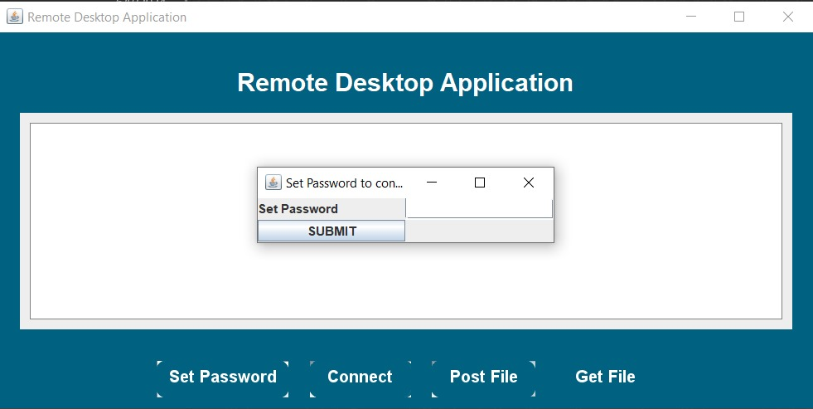
Main Functions
1. Set Password: Allow administrators to set a secure password for remote desktop access.

Slide 9
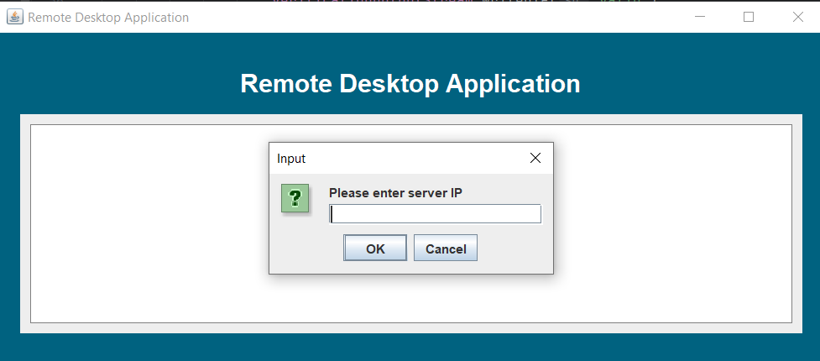
2. Connect: Establish a connection between the local and remote systems for remote desktop control.

Slide 10
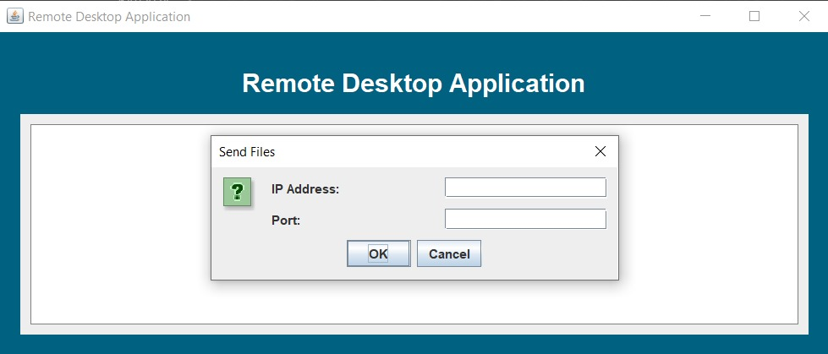
3. Post File: Enable users to securely upload files from the local system to the remote system.

Slide 11
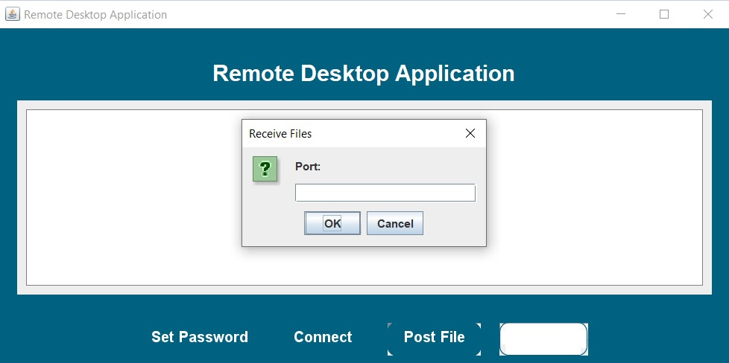
4. Get File: Facilitate users in securely downloading files from the remote system to the local system.

Slide 12
Thank You !

